Slide 1
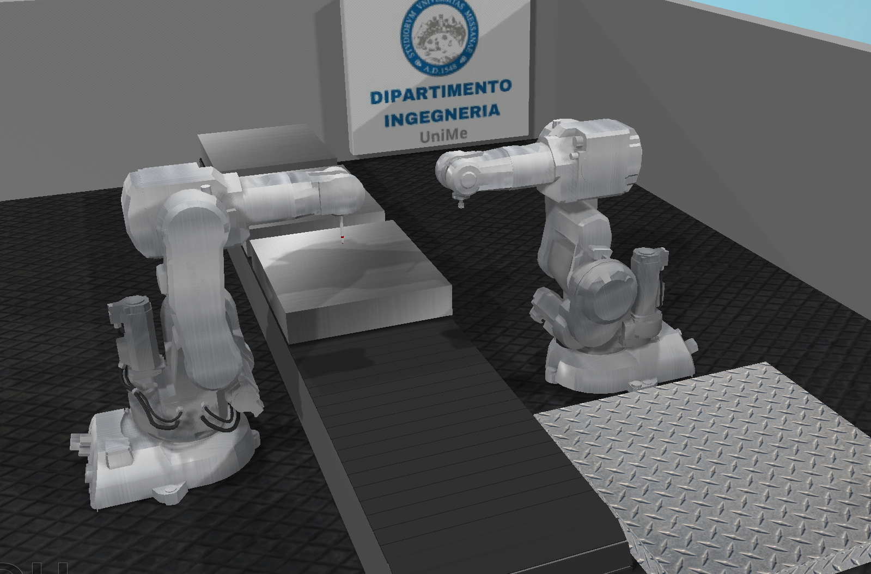
Robotic Cutting System on CoppeliaSim
Written by: Roberto Cardillo Alessandro Ficarra Gabriele Ielo Gabriele Ruggeri
Teacher: Prof. L. Patanè

Slide 2
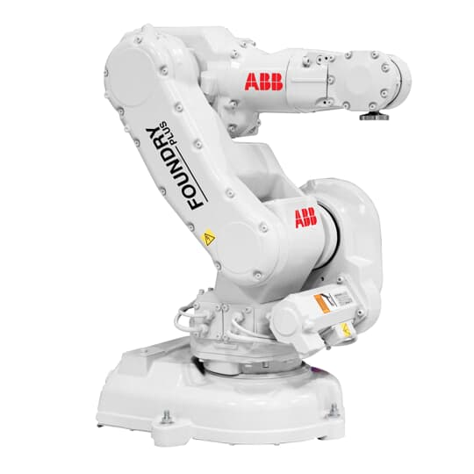
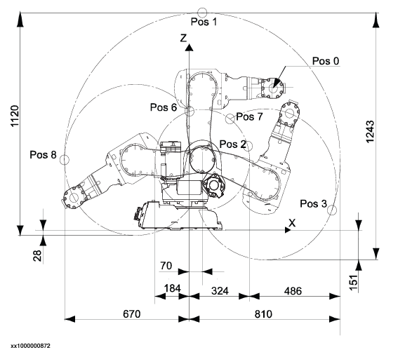
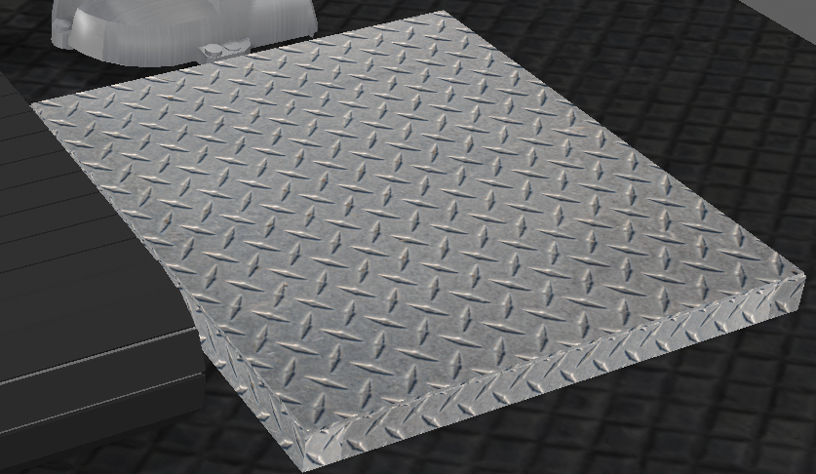
Scene Description
2 Robot IRB140: IRB140[0] and IRB140[1]
Conveyor Belt
2 Proximity Sensor
Customizable Table
Cuboids

Slide 3
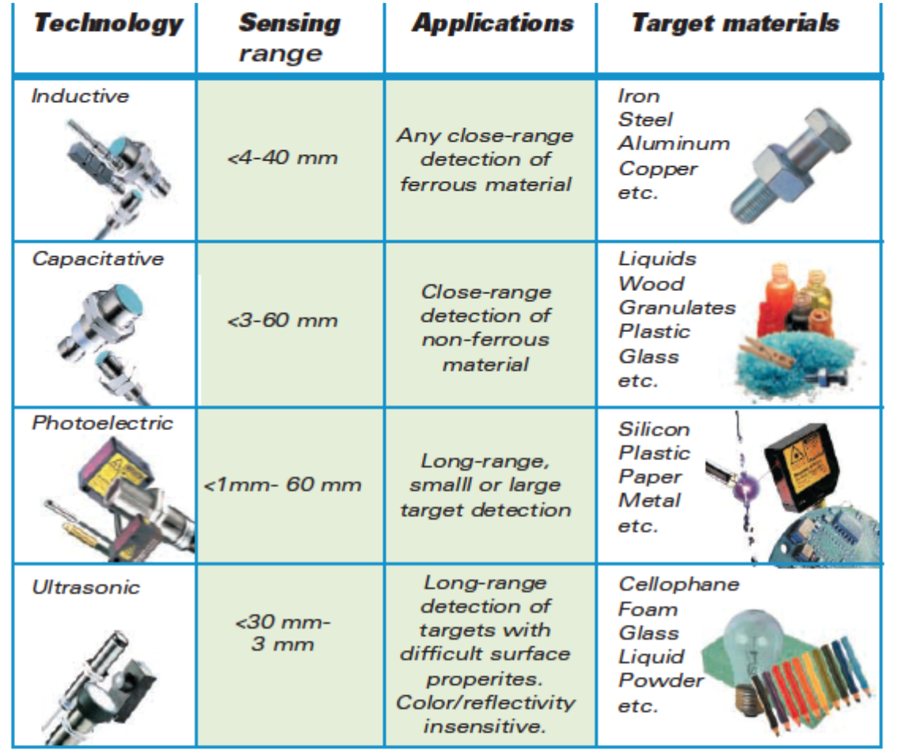
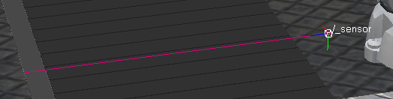
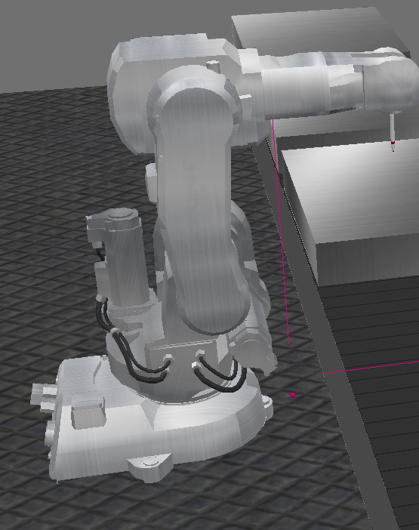
Proximity Sensor
We chose Inductive proximity sensor since our target materials are cuboids of steel.
The first is on the conveyor belt hierarchy and, when the target gets sensed by it, the first IRB140 starts its routine.
The second proximity sensor is on the first IRB140’s trajectory instead, and, when it senses the presence of the arm, it activates the second IRB140’s routine.

Slide 4
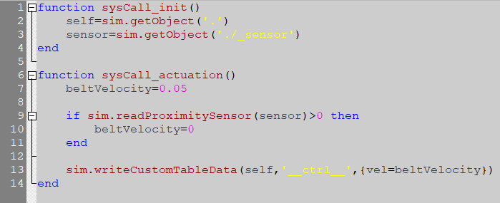
Conveyor Belt
We set the conveyor belt to have a velocity of 0.05 m/s, if the proximity sensor detects the target, the conveyor belt will stop.
The last row commands the conveyor belt restarting the movement the moment the target leaves the sensor.

Slide 5
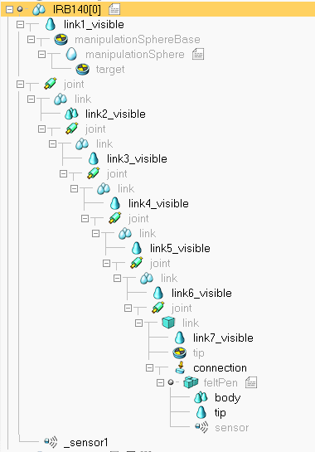
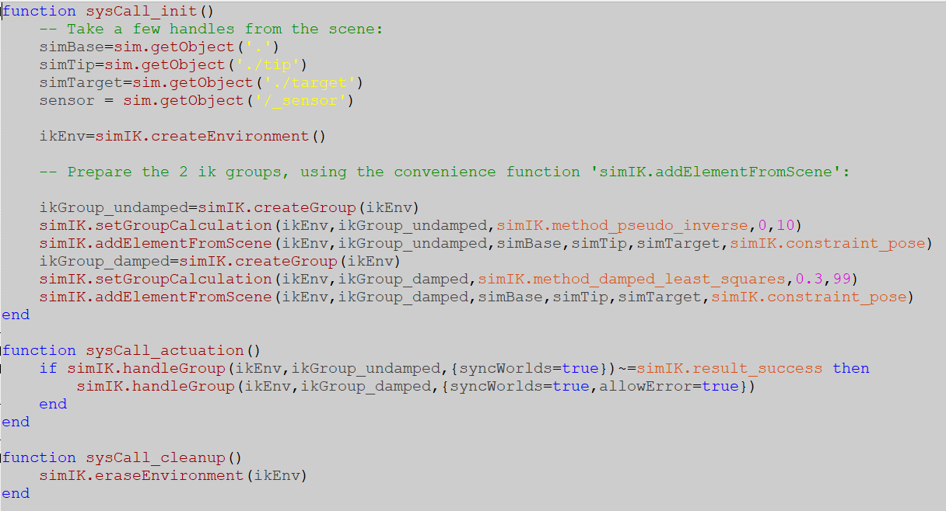
IRB140[0]
Hierarchy Script

Slide 6
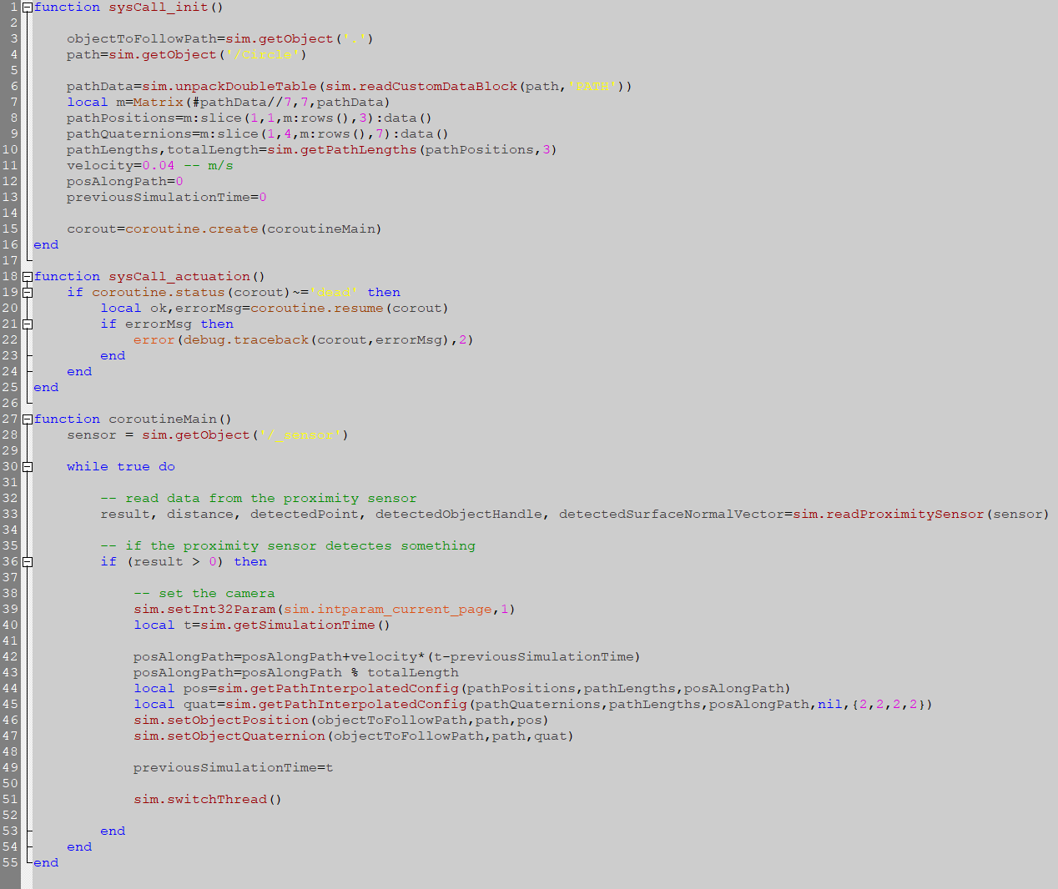
IRB140[0] Movement
This is the code relative to the ManipulationSphere, it makes it so that the end-effector of the cutting tool follows a circular path.
After accomplishing this task, the arm frees the workspace and activates the second proximity sensor which then turns on the second arm’s routine.

Slide 7
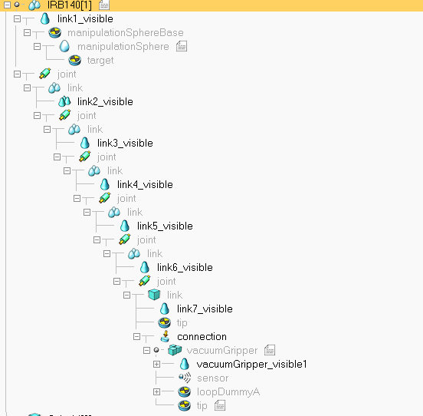
IRB140[1]
This robot’s script was taken from a default scene of the software ‘ur5WithRg2Grasping’, and customised for our needs. The gripper has been swapped out for a vacuum gripper and the joints’ revolute movements were changed to place the plates on the Customizable Table.
A while cycle was added to the main for the pick and place script: when the sensor detects the presence of the IRB140[0] the second robot’s routine then starts and, via forward kinematics and inverse kinematics, it moves the cuboid towards the table.
Once the while cycle is over it then goes back to the default position.
Hierarchy

Slide 8
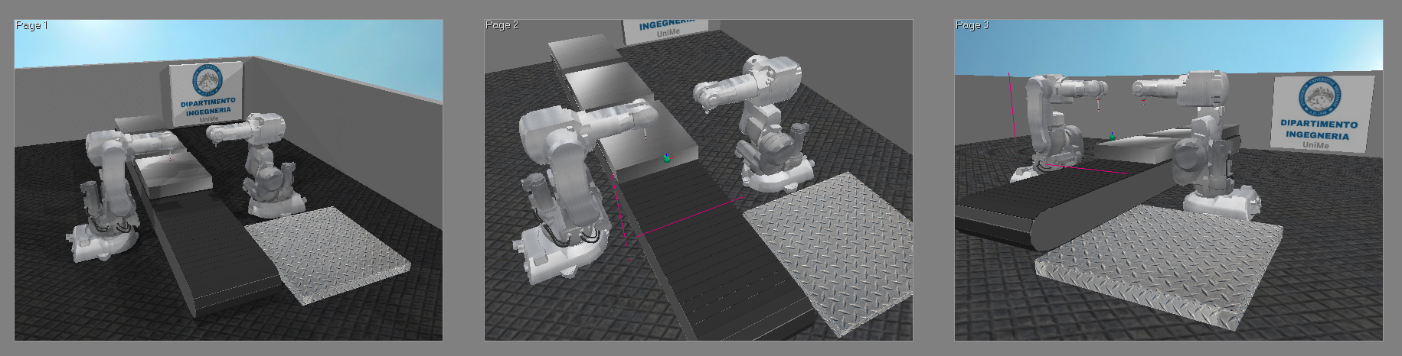
Camera Direction
Camera 0 Camera 1 Camera 2
The cameras were set up in a way that allows us to showcase in great detail every step of the process.
The first frame, shot by camera 0, showcases the workspace in its totality. The second frame, shot by camera 1, showcases in detail the cutting step, while the third frame, shot by camera 2, showcases the pick and place routine.
A more detailed and refined light and surface rendering was added in order to make the scene more aesthetically pleasing.

